Slide 1
Module 8: Build Power Automate desktop flows

Slide 2
Desktop flows
Build desktop flows
Use desktop flows
Process advisor

Slide 3

What is Robotic Process Automation (RPA)?
Robotic process automation (RPA) automates repetitive tasks by recording the user actions in the application and repeating those actions directly in the application user interface
With RPA you can automate legacy software without APIs
Power Automate
bridges the gap,
across on-premises and cloud
Old apps
without APIs
Modern Systems
with APIs

Slide 4
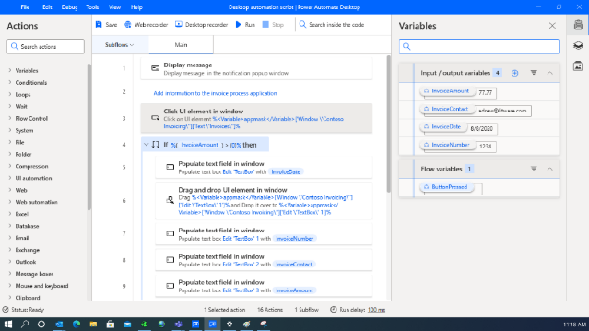
Power Automate for desktop
Low-code/no-code drag & drop approach with recorders (desktop and web)
Advanced error handling and debugging
Reusability of controls, images and functions
Support for advanced coding-scripting (VBScript, JavaScript, Python, PowerShell, Command Line)
Attended and unattended execution mode
Concurrent process execution

Slide 5
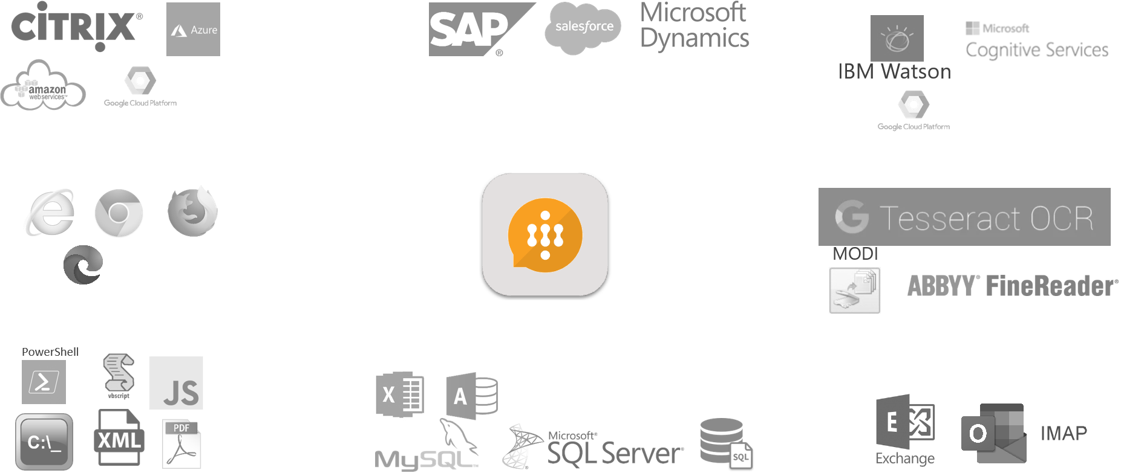
Includes almost 400 actions
Web - desktop applications
Citrix and VDI Environments
Cloud automation (Microsoft Azure, Amazon AWS) and Cognitive capabilities (IBM, Google, Microsoft)
Databases-SQL Excel
PDF & XML
Files, folders and mouse-keyboard
Email (IMAP, smtp, exchange, outlook)
Computer vision and image recognition
Encryption – cryptographic actions, CyberArk support
OCR for structured and unstructured data capturing and handling
Cloud / virtualization
Cognitive
Web automation
OCR
Scripting - Systems
Databases
Emails
© 2021 Microsoft. All rights reserved.

Slide 6
Steps to build a desktop flow
Record the task
Edit, test and validate
Playback to
execute the task

Slide 7
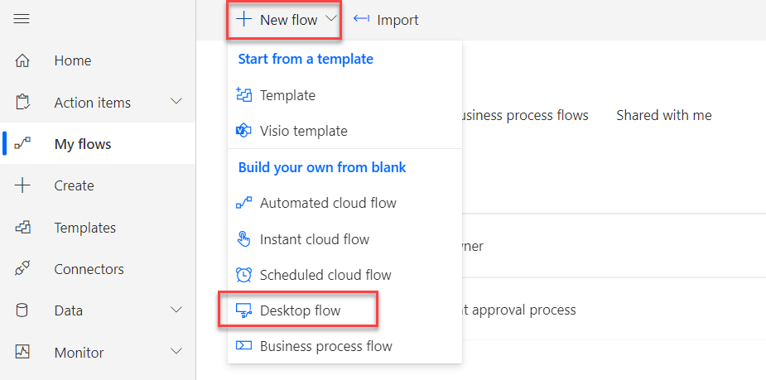
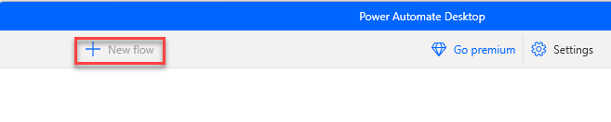
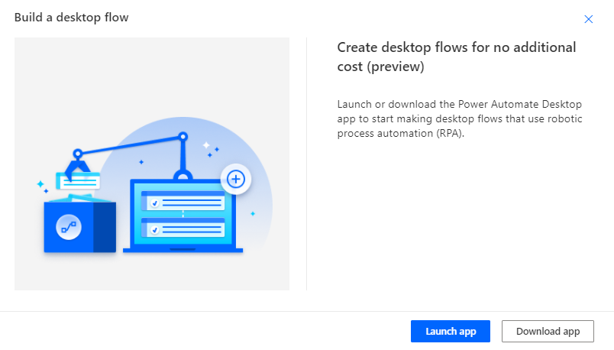
Starting a new automation
From the web
From the desktop

Slide 8
Recording
Launch app or web site and record doing the repetitive work
Be prepared, practice what you plan to record
You can edit recorded steps after to adjust

Slide 9
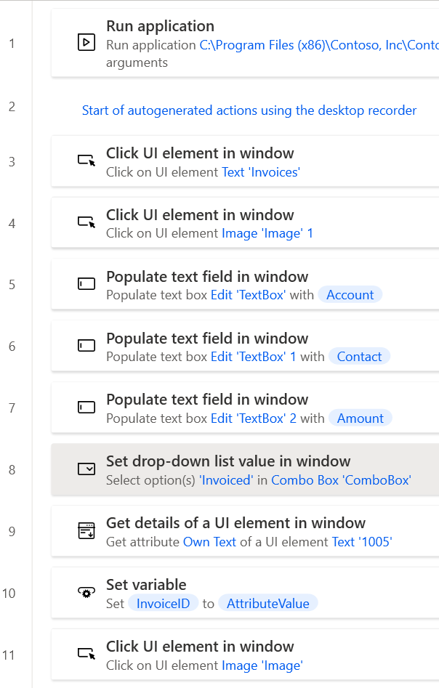
Edit Actions
Drag and drop to re-order
Copy and paste supported
Edit properties on action steps
Disable steps
Select multiple steps

Slide 10
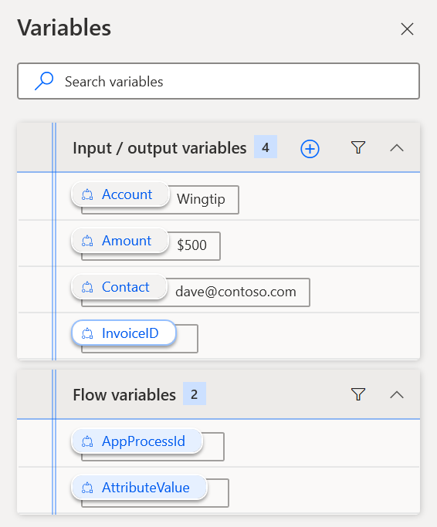
Variables – Input, Output and Flow
Use input variables to pass dynamic data into the flow steps
Use output variables to make outcomes available
Use flow variables to hold values between steps

Slide 11
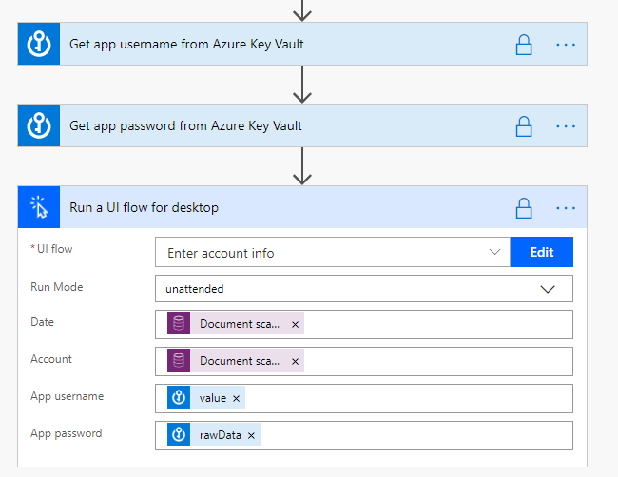
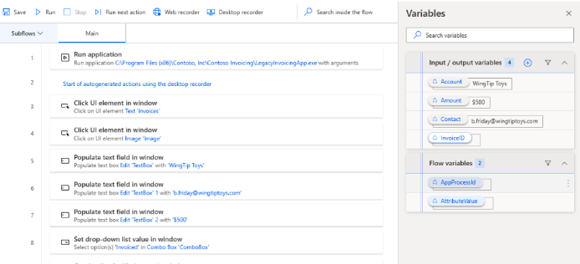
Using Inputs and Outputs
Define inputs/outputs in desktop flows
Bind them in the flow that runs the desktop flow

Slide 12
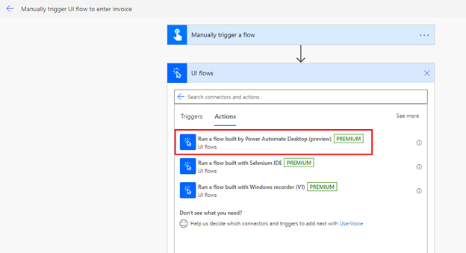
Using desktop flows in your architecture
When you author a desktop flow to automate an application, it can be created and tested standalone
To run it, you can call it from an action in a Power Automate flow or start it from Power Automate for desktop.
The desktop flow can be used in multiple flows making it a reusable component

Slide 13
Where the application is executed
Attended
Unattended
Execution requires the user to be logged in to their computer and execution uses an existing Windows user session
When the cloud flow runs the desktop flow step the user will see the application start on their computer and the user should avoid interacting with it while execution occurs
Execution requires one or more Windows computers to be configured to run the application being automated
When the desktop flow step is executed, the application is started on one of the configured computers in the background
The option to have desktop flows run attended or unattended can be configured in each flow that uses the desktop Flow, you can tailor the option on each flow that uses the flow action

Slide 14
Process advisor
Use the recorder from Power Automate for desktop
Record users as they go through your steps
Evaluate the process and get suggestions for improvement

Slide 15
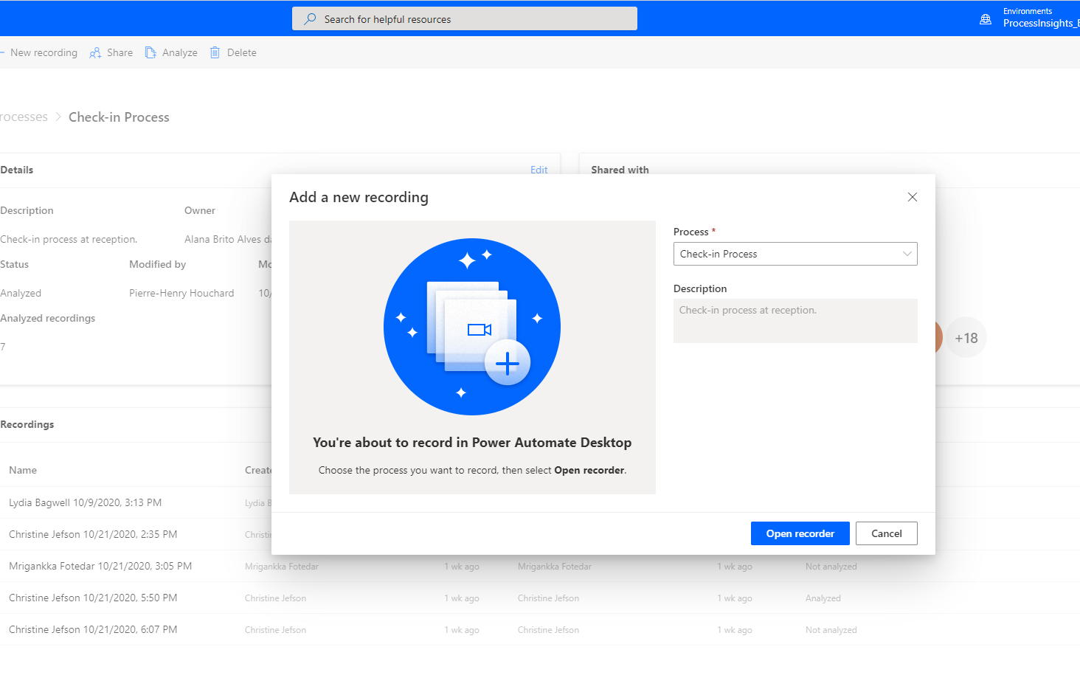
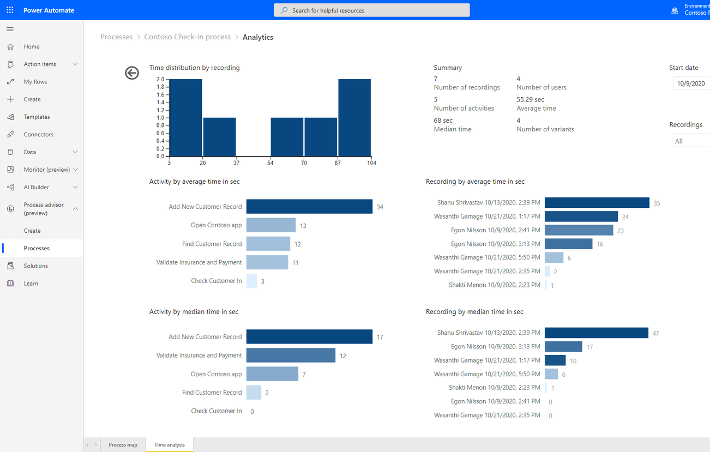
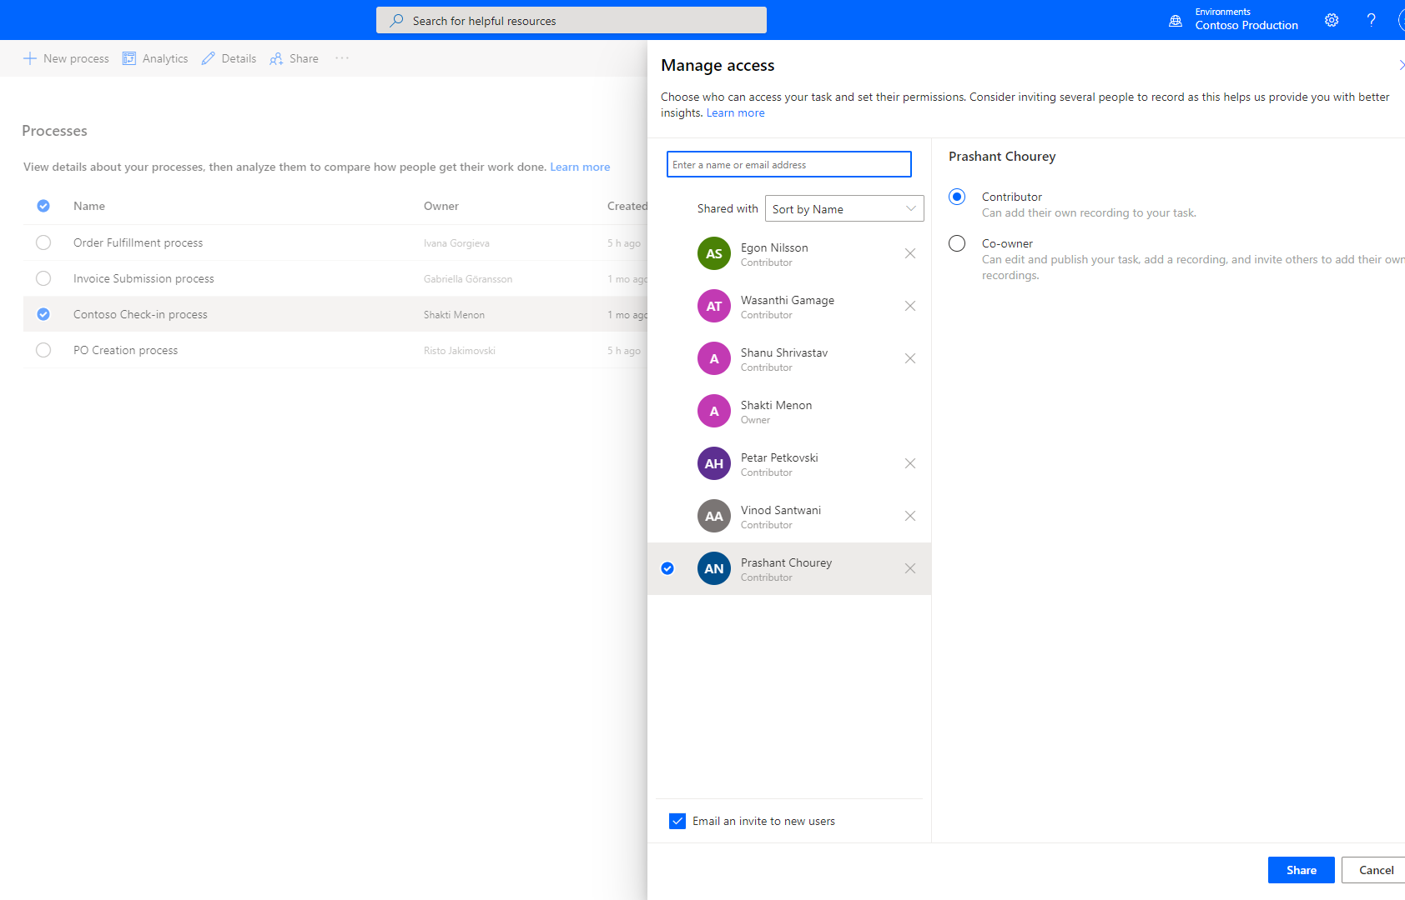
Process advisor for process mining
Get started quickly with the intuitive interface for capturing and recording your tasks.
Gain deeper insights on processes and break down complex processes.
Discover new ways of working and drive collaboration.

Slide 16






Steps for using process advisor
Create
Set up a new process and identify potential areas of opportunity for automation.
Share
Invite colleagues to collaborate and add new recordings.
Record
Record the actions either you or your colleagues take to complete the process at hand.
Annotate/Edit
Remove sensitive information, then group your actions into meaningful activities.
Analyze
Generate a process map so that you can analyze it and get insights.

Slide 17
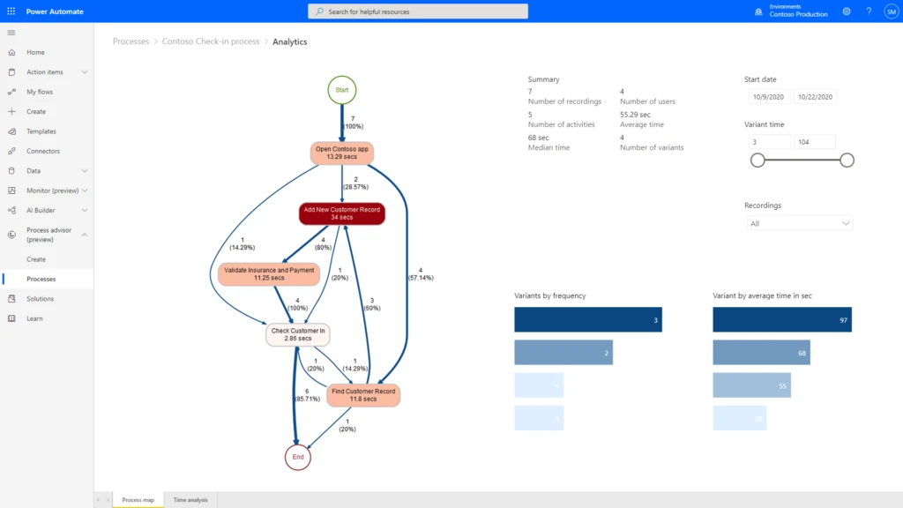
Use process maps to understand the work

Slide 18
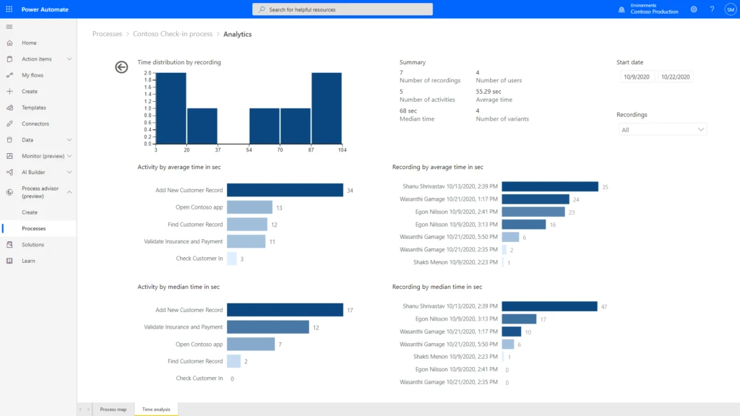
Use analytics to understand variations

Slide 19
Summary
Not every application offers an API, desktop flows help automate those tasks
Use process advisor to evaluate and better understand the processes you use
For hands on with desktop flows, try RPA-in-a-day at https://aka.ms/rpainaday

Slide 20
close

